Slide 1
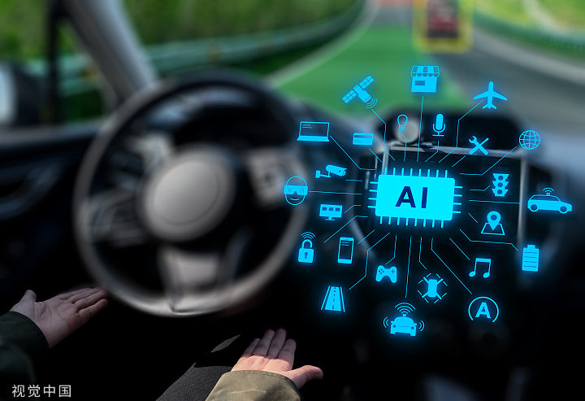
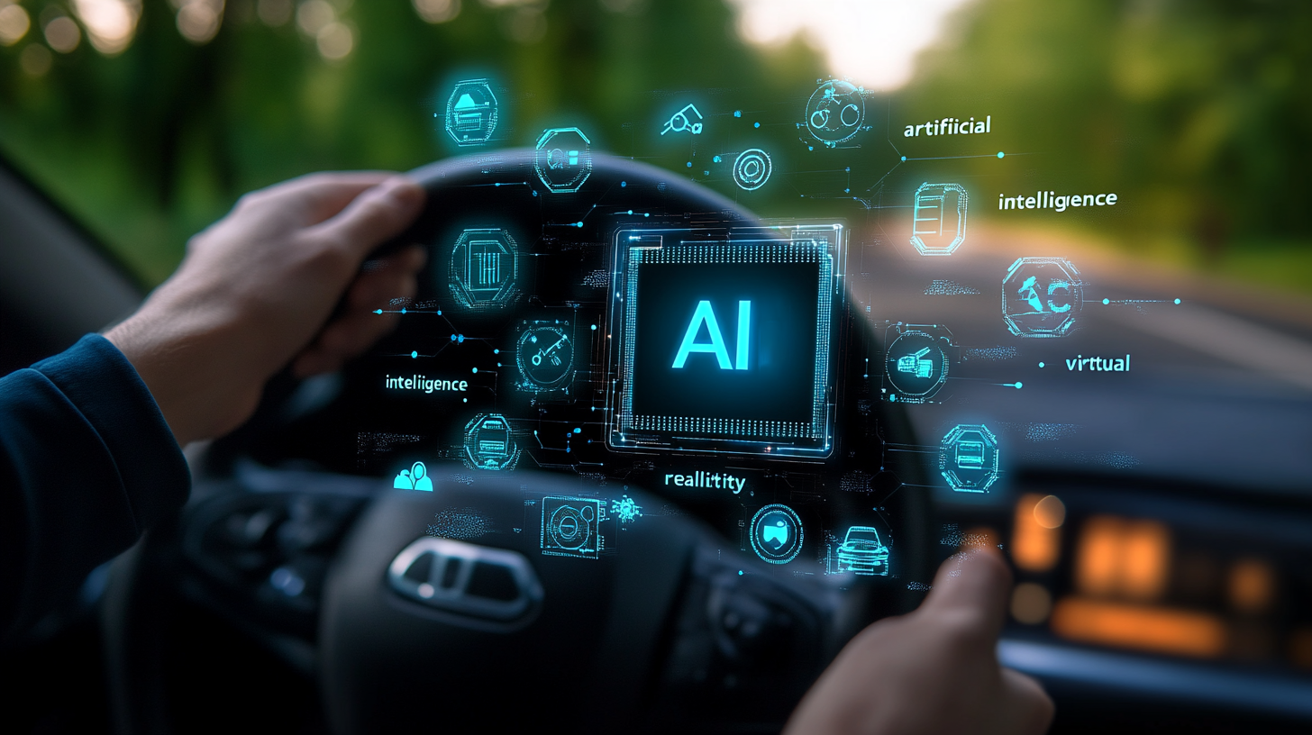
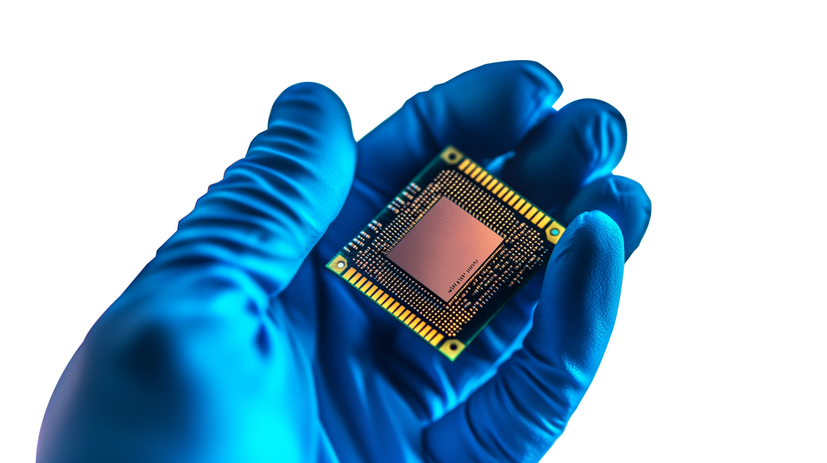
`
Bio-Medical
AI-Powered Personal Health Management
Application
Team 12
Sara Al Sowaimel, Yihao Shen, Haorui Chen

Slide 2

Definition and Scope
Introduction to Biomedical AI
Bio- medical Artificial Intelligence using data collected from wearable sensors and health monitoring devices to:
Analyze health conditions
Explain symptoms
Provide personalized health and fitness plans
record data and sharing with medical professionals for personalized treatment plans.
1
2
Target Users
The target audience includes the general public, with a focus on ordinary individuals who may not have a medical background, enabling them to understand their health conditions and receive tailored health advice.
3
Social Impact
Addressing the uneven distribution of medical resources, our AI aims to bridge the gap between urban and rural medical diagnosis experiences, reducing misdiagnoses and improving overall healthcare quality.

Slide 3
User Stories
1
Uneven distribution of Medical Resource
2
Leak of Experience
3
Medical Rumors

Slide 4

User Stories
1
Uneven distribution of Medical Resource
2
Leak of Experience
3
Medical Rumors
Combating Medical Rumors
Access to Health Information
The AI will serve as a reliable source of medical information, countering the spread of misinformation on social media platforms and providing users with accurate symptom understanding.
Users will gain access to a next-gen AI application that provides health condition insights and personalized health plans.
Prevention of Misdiagnosis
By analyzing data from various health monitoring devices, our AI can help prevent misdiagnoses, particularly in areas with limited medical resources.

Slide 5

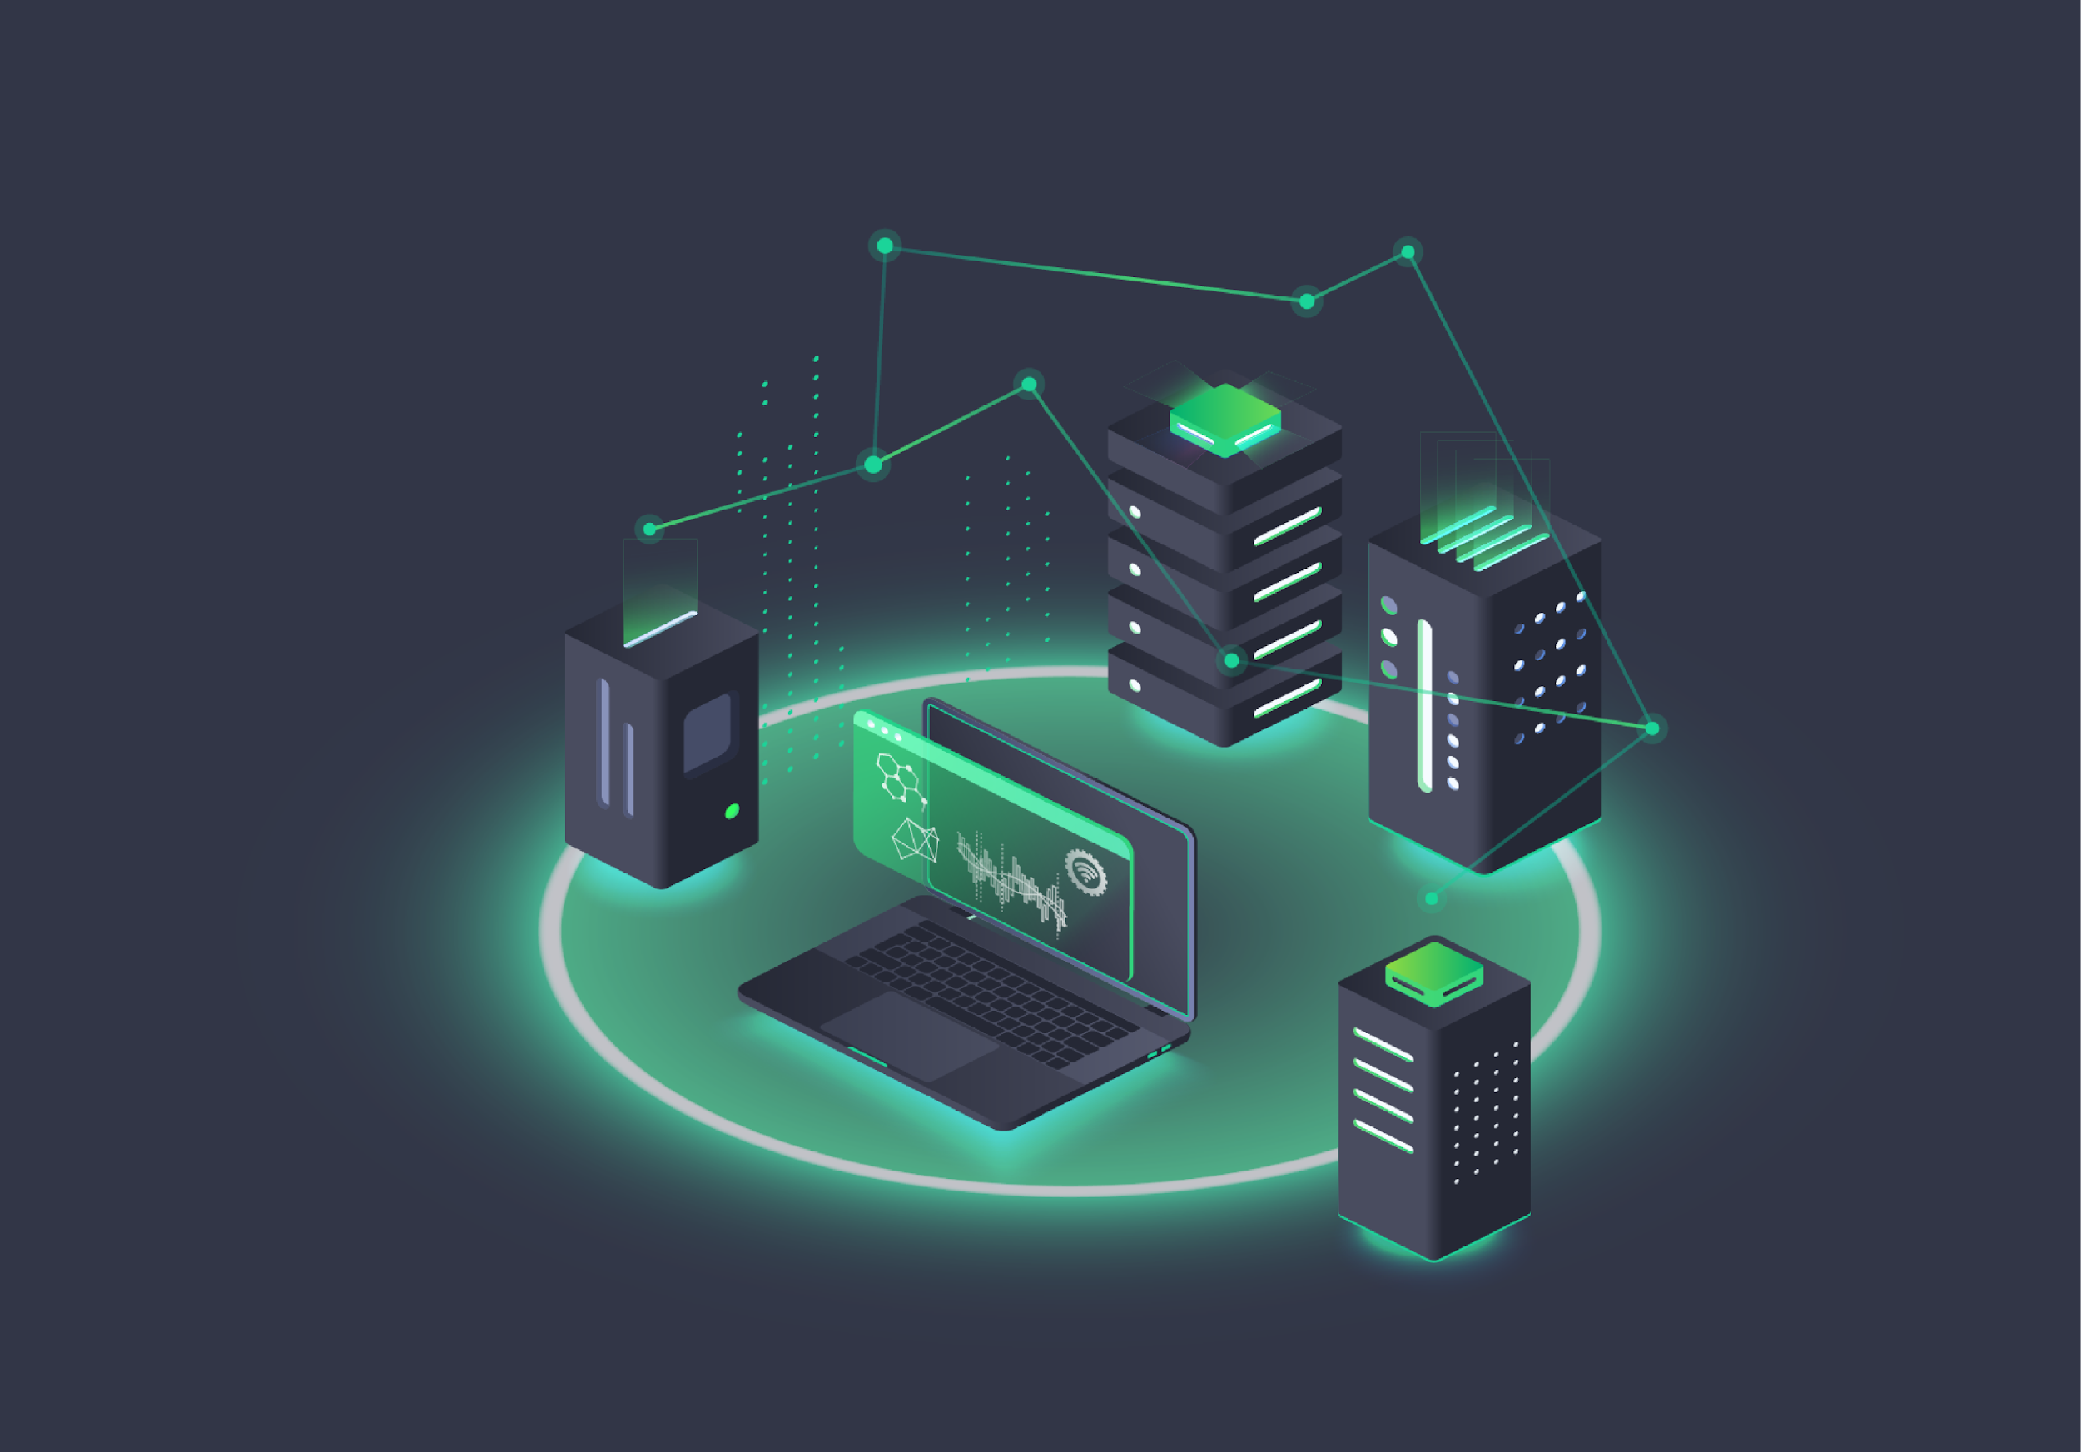
Minimum Viable Product (MVP)
1
2
Core Database
Interactive Software
A database for our software to retrieve and compare with the data collected by wearable medical devices or provided by user.
An interactive software for recording and analyzing health history, and a system for generating personalized health tips.

Slide 6
Sprint 2 Progress
Ongoing Challenges
Database Development
Encountered challenges in programming and finding in- depth information, which are being actively addressed.
Implementation Initiation
Worked on formulating a database to collect and manage health data from various sources.
Began the implementation phase, focusing on integrating health monitoring devices with the AI application.

Slide 7
Thank you
Notes:
Notes/Suggestions/questions: for next sprint: what kind of tests have you done? Look for open source records to test the work. We can use chatgpt do that

